Slide 1
BAIT 3013 BUSINESS INTELLIGENCE
Sales & Purchase Performance: A Quick Analysis
Programme : RMM (Intake:202006)
Tutorial Group : G2
Group name : Three Monkeys
Student : Fong Wei Chen, Eng Wei Hang, Wong Ke Ying

Slide 2



Slide 3
BACKGROUND
A company leading Global Electronics Manufacturing Services (EMS)
Offer high value manufacturing solutions and services since 1992.
Two Branches
Bukit Tengah
Batu Kawan
Certified with IATF 16949, ISO 9001 and ISO 14001
Product serving Divided in 7 categories
Automotive
Storage device
Consumer
Communication
Industri equipment
DRAM modules
Optical
Service provided
Supply Chain Management
NPI Program Management
Quality Management
Traceability and Data Management

Slide 4

PROBLEM STATEMENT
Manual Bookkeeping System to record business transactions and financial records
Problem facing
Pooling data process ------> Troublesome and time Consuming
Delay in providing a real-time analysis result
Delay the process of reporting critical information
Difficult in assessing their sales & purchases performance
Difficult in making decision of procurement and sales
Wasn’t able to select the best supplier
Difficult to compare sales margin
Can’t determine their best products and customers

Slide 5

PROJECT SCOPE
Use BI software (tableau)
solving the technical problems faced
analyzing the sales and purchase data
Show the sales and procurement overview in each year
Find out the top few vendors and top items purchased
Find out the top customers and best sales products
Analyze the delivery performance of Hotayi and vendors
Predict sales and purchases performance in the next three years
Calculate total sales margin earned and year over year growth rate

Slide 6

DATA REQUIREMENT
Data set provided by Hotayi
Categorized
Sales data
Purchases data
Insufficient data
Contract date → Purchase table
actual received date → Sales table
Perform data cleaning

Slide 7
DATA REQUIREMENT (Purchase)
Data Name | Data Description | Data Type
Purchasing Doc No | Purchasing document number | String
Receipt Date | The date the materials purchased were received | Date
Contract Date | The date the materials are promised to be shipped out | Date
Project Code | Project ID | Integer
Vendor No | Vendor ID | Integer
Receipt Amount | Amount paid for the purchases | Float
Country | Country of the vendor | String
Trade Term | Trade term (can also call terms of shipment) | String

Slide 8
DATA REQUIREMENT (Sales)
Data Name | Data Description | Data Type
Sales Doc No | Sales document number | String
Shipping Date | The date the products were shipped out | Date
Actual Received Date | The date where customer received the materials | Date
Customer No | Customer ID | Integer
Project Code | Project ID | Integer
Sales Amount | Amount earned from the sales | Float
Country | Country of the customer | String
Transport Type | Type of transport used for shipment | String

Slide 9
Change to Tableau

Slide 10
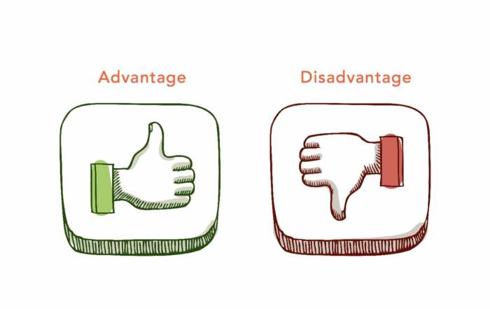
ADVANTAGES AND DISADVANTAGES
Dashboard 1 & 7 (Descriptive Analysis)
Dashboard 2,3,4,8,9 & 10 (Diagnostic Analysis)
Dashboard 5 & 11 (Predictive Analysis )
Dashboard 3 & 6 (Prescriptive Analysis)

Slide 11
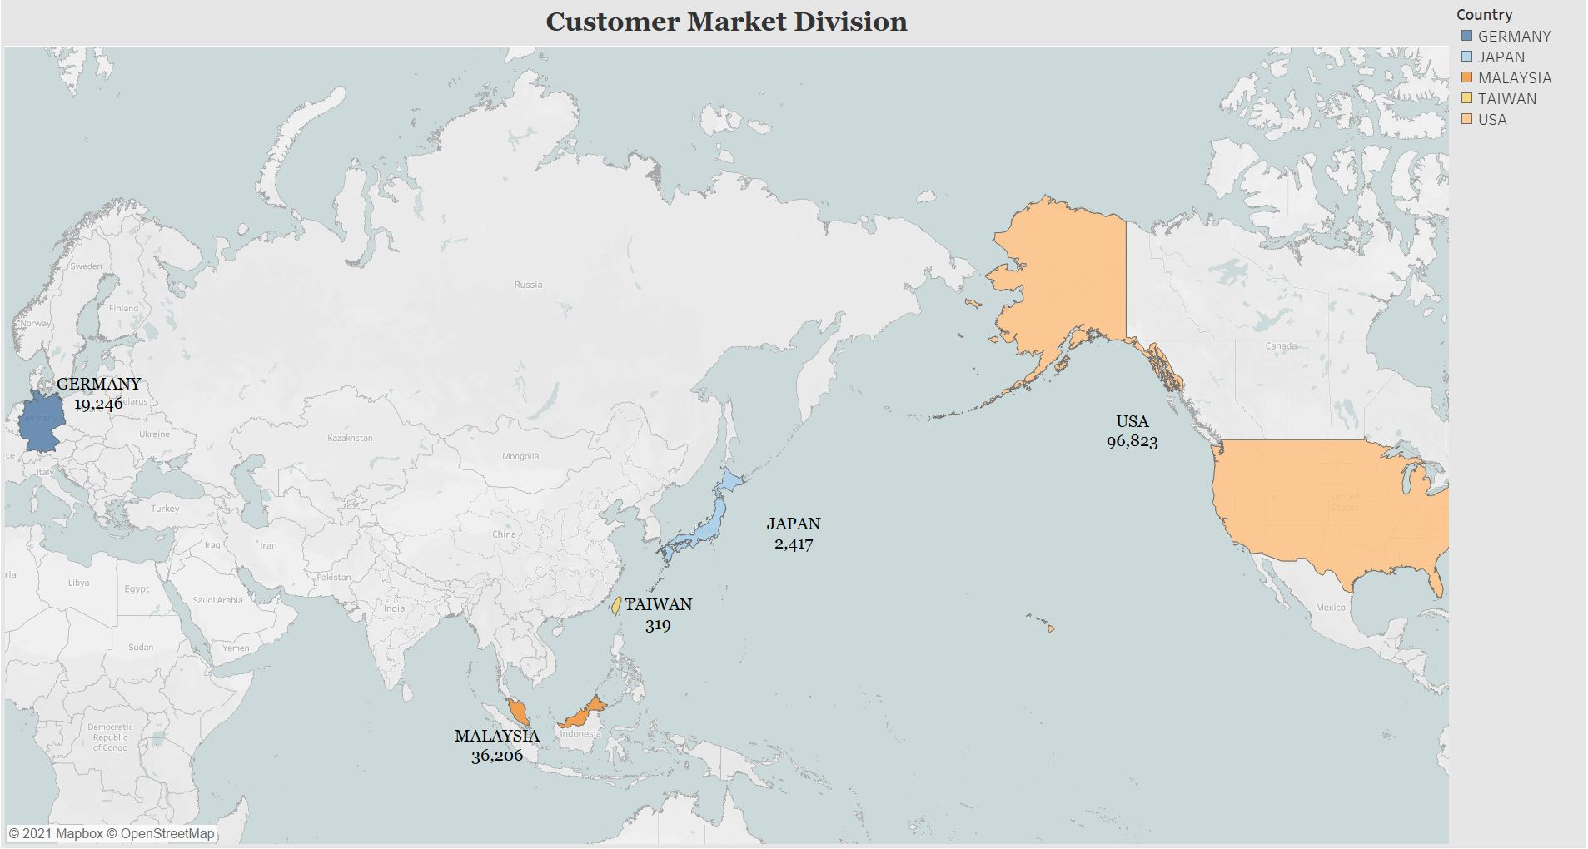
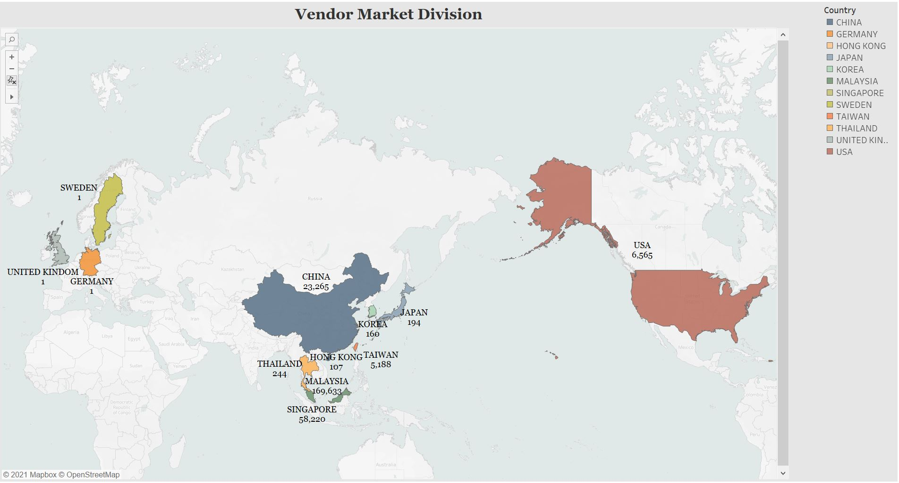
DASHBOARD
Descriptive Analysis
Used to describe the basic features of the data in a research
Simplify large amounts of historical data
Advantages > Displays all the things at a glance
Disadvantages > Will be messy when there is a large number of data

Slide 12
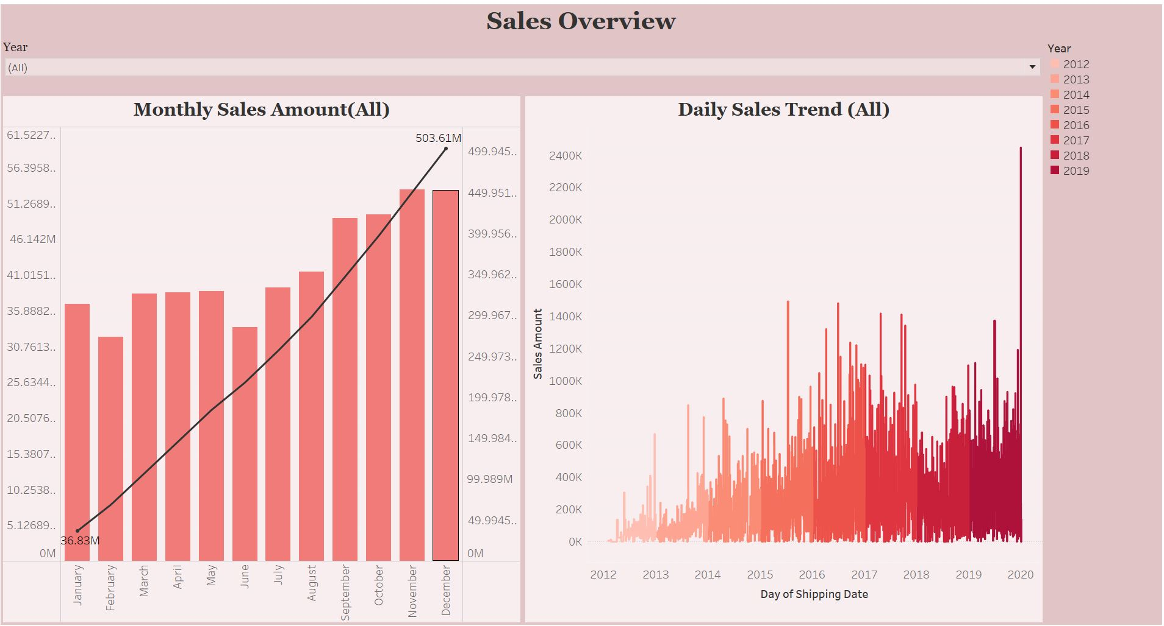
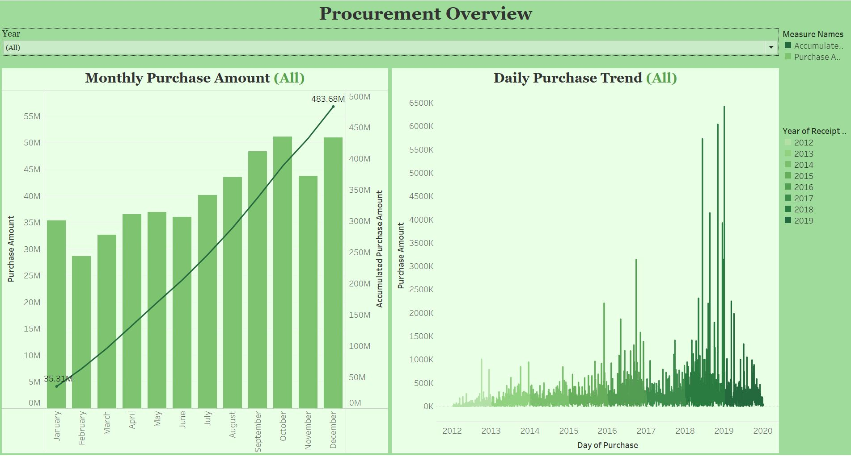
Diagnostic Analysis
Takes one step further of descriptive data
Provides insight into the reasons behind the current situation that is happening now
Explore the data and make correlations between each data

Slide 13

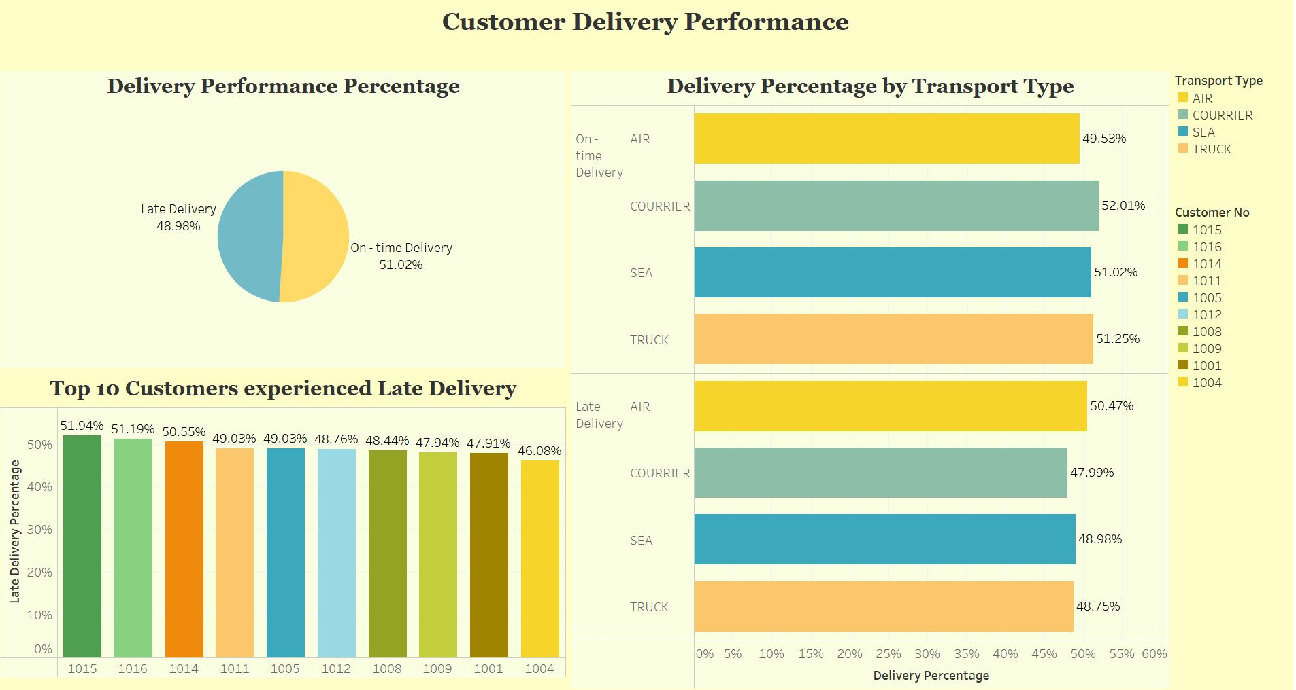
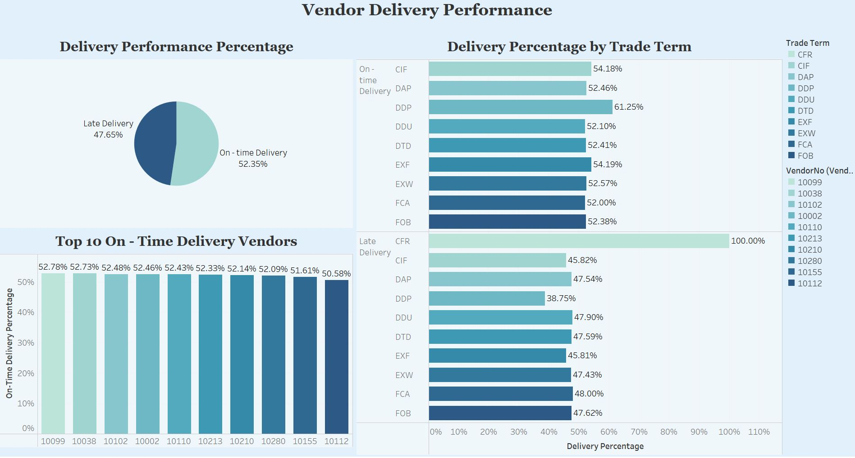
Able to determine the major factors
Provide a clear brief review of the analysis

Slide 14
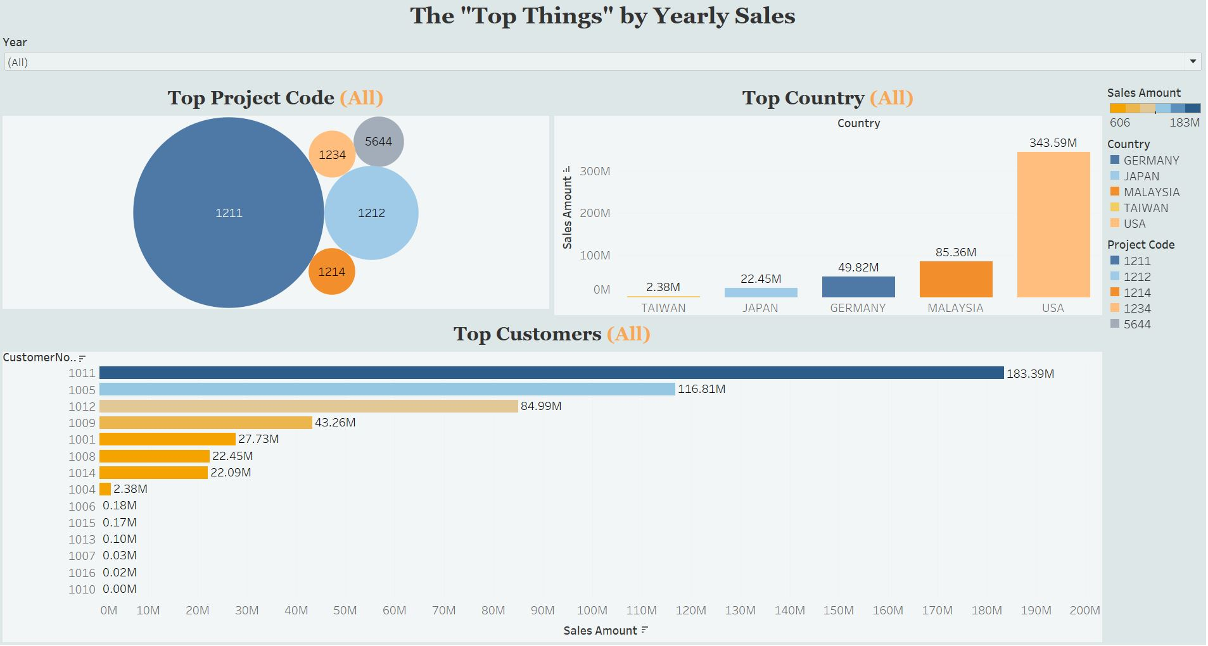
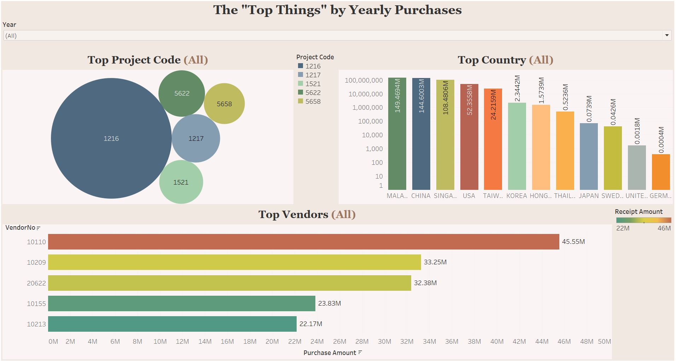
Disadvantages
Some invalid data or the missing value will become null value
The accuracy will be affected

Slide 15
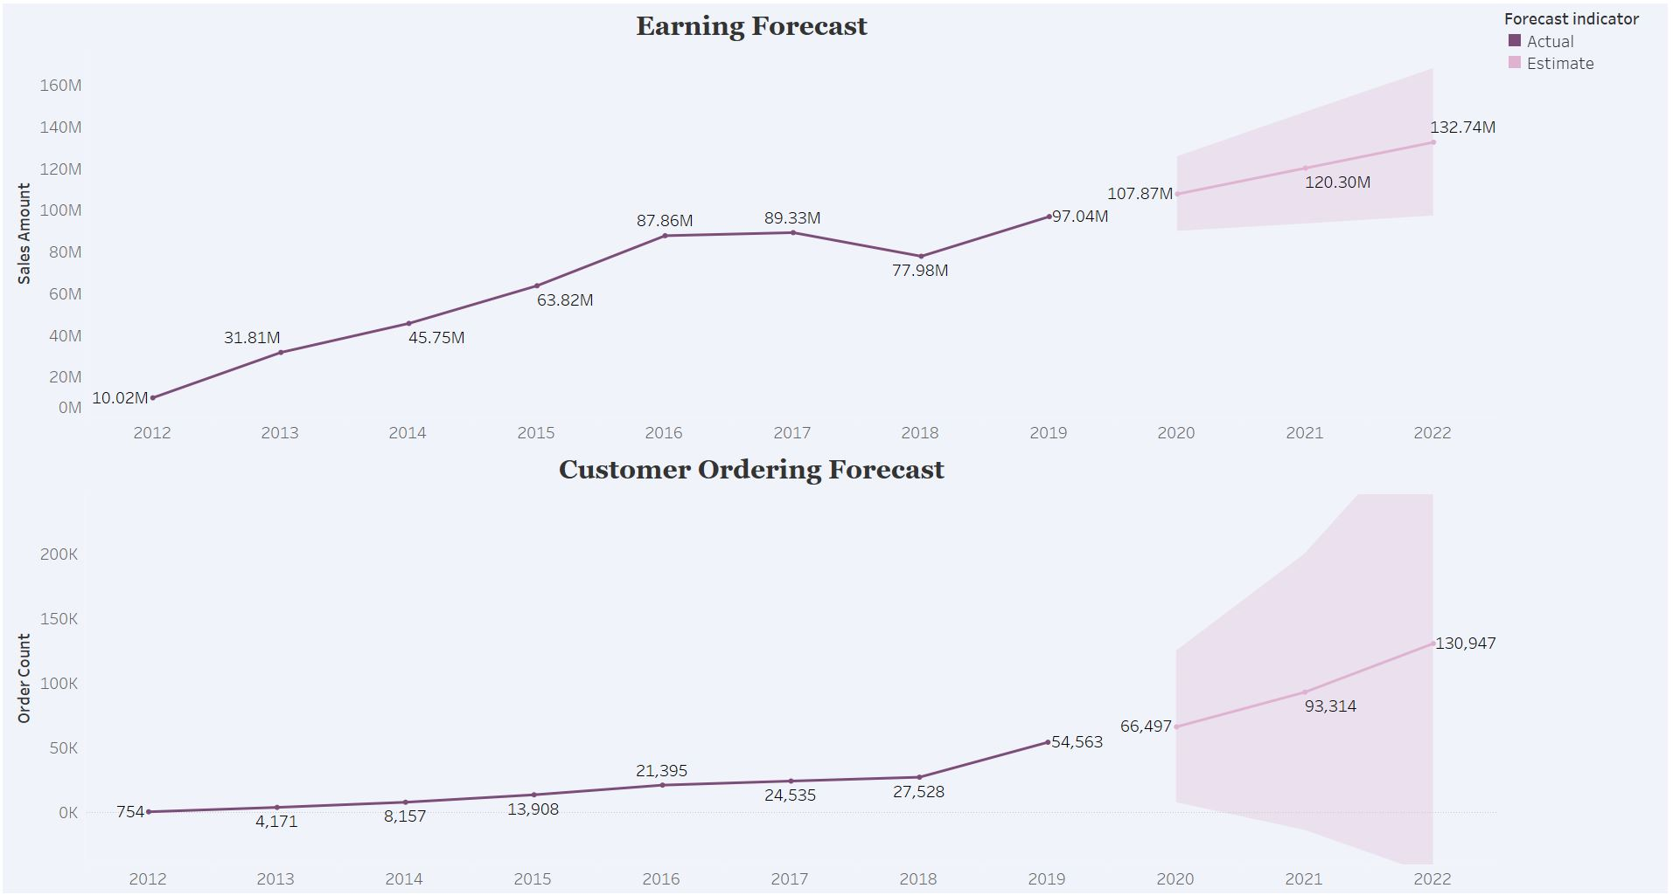
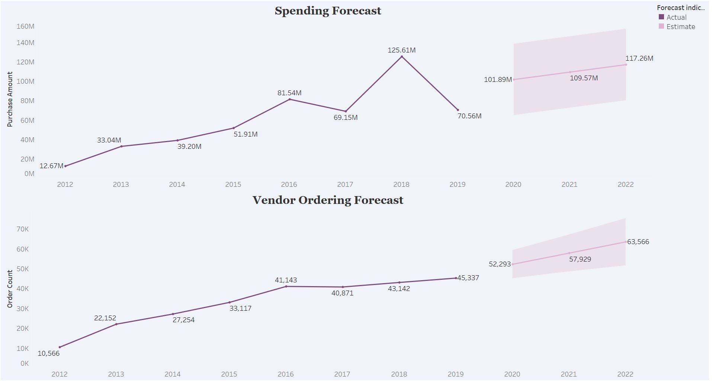
Predictive Analysis
Takes historical data and current data to predict future trends and what will happen next
Estimate the following year trend performance
Advantages > Have an idea of company future growing
Disadvantages
> Analysis can be misleading
> Predictive models are not always 100% accurate

Slide 16
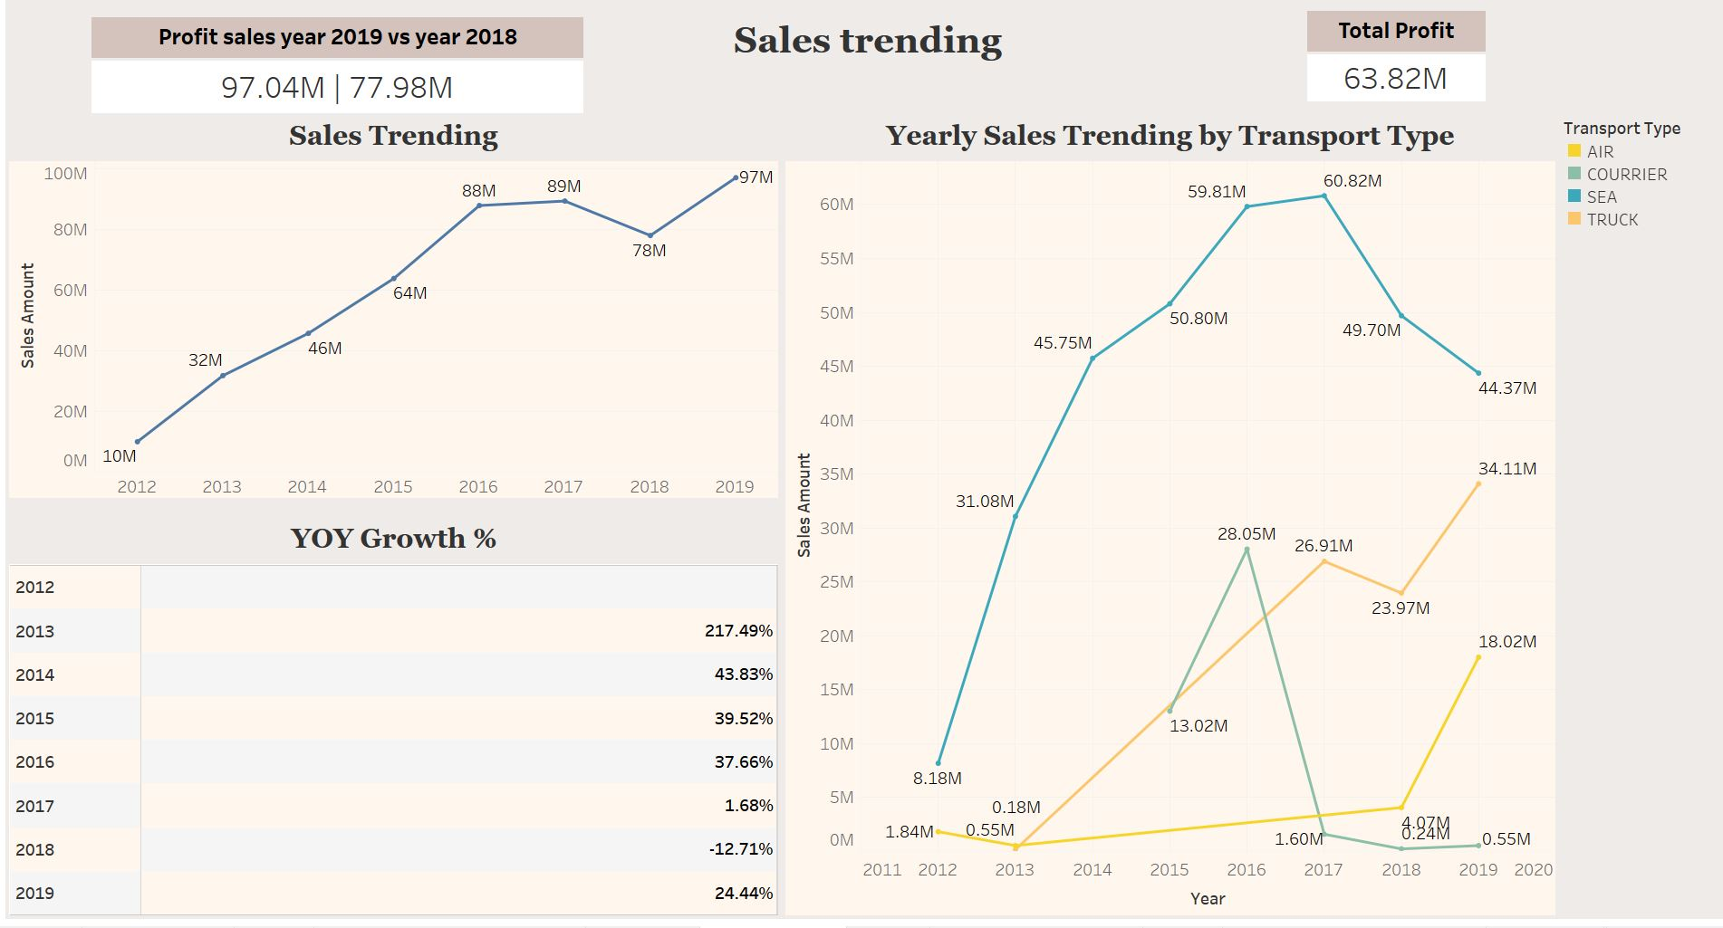
Prescriptive Analysis
Takes predictive data to the next level
Recognize the past performance, current trends, and possible forecasts
Suggest and provide decisions, action or strategy to achieve the best performance
Advantages > Helps users to make better decisions
Disadvantages > There is no disadvantages

Slide 17

CONCLUSION
Problems solved using Tableau
Provides timely insights without consuming much time
Able to identify business performance
Increase the speed of process of reporting critical information
Analyze the sales & purchases performance in a short period of time
It can suggest and recommend better decision making to boost the performance

Slide 18

THANK YOU !!!

